Slide 1
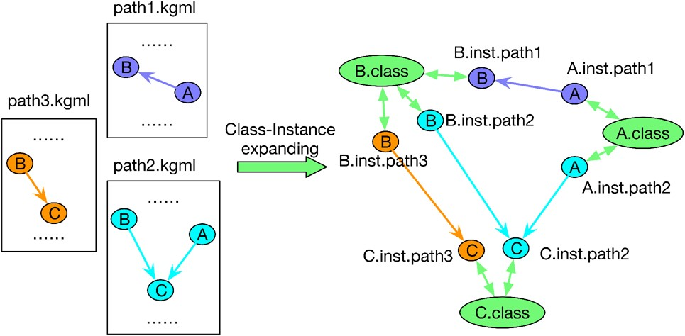

Fig. 2. An illustration of class-instance relation. Suppose in KEGG, gene A has relations with B and C in two ...
Notes:
Fig. 2. An illustration of class-instance relation. Suppose in KEGG, gene A has relations with B and C in two separate pathways. After class-instance expanding, gene A would have two instances, where the instance in path1 interacts with instance of B and the instance in path2 interacts with instance of C. The original genes A, B and C become classes
Unless provided in the caption above, the following copyright applies to the content of this slide: © The Author(s) 2019. Published by Oxford University Press. All rights reserved. For permissions, please e-mail: journals.permissions@oup.comThis article is published and distributed under the terms of the Oxford University Press, Standard Journals Publication Model (https://academic.oup.com/journals/pages/open_access/funder_policies/chorus/standard_publication_model)

